Slide 1
PHARMACY DATABASE AND BILLING
Bachelor of Engineering in
Information Science and Engineering
Submitted by:
1.Akshatha B Anjutagi 1NT19IS401
2.Lavanya k 1NT19IS407
3.Renuka Karadagi 1NT19IS412
4.Yashodha M N 1NT19IS416
Name Of The Faculty : Mrs Disha D N

Slide 2
INTRODUCTION
We give a solution for a better and efficient way to handle and maintain a Pharmacy Billing system where the data entered can be stored in Database using Database Management System and A Website for the Pharmacy though which the Database can be handled.
The Database and Website are linked through PHP(Personal Home Page) by an application Apache2.

Slide 3
PROBLEM STATEMENT:
Pharmacy management has kept paper record in filing cabinets.
Managing a very large pharmacy with records on papers will be tedious and difficult to keep track of inventories with regards to the drugs in the store, expiry date, quantity of drugs available based on the categories and their functions.

Slide 4
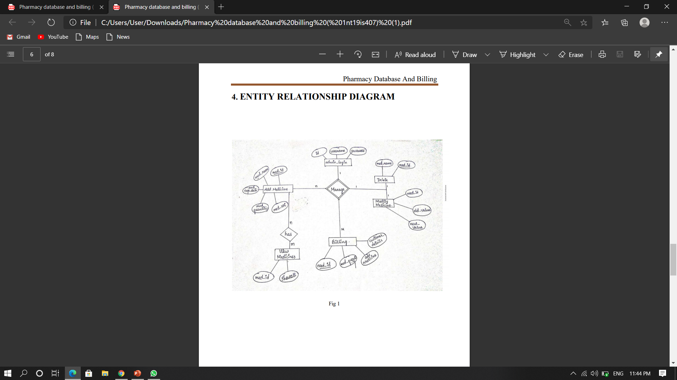
ENTITY RELATIONSHIP DIAGRAM

Slide 5
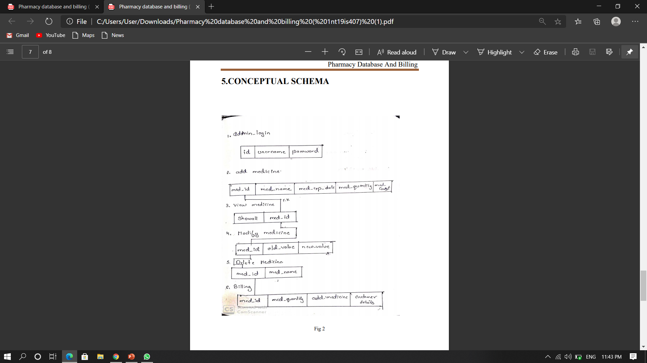
CONCEPTUAL SCHEMA

Slide 6
WORK DISTRIBUTION
Front End : LAVANYA K
BACK END : AKSHATA B ANJUTAGI
DEMO : RENUKA KARADAGI
PROJECT PPT : YASHODHA M N

Slide 7
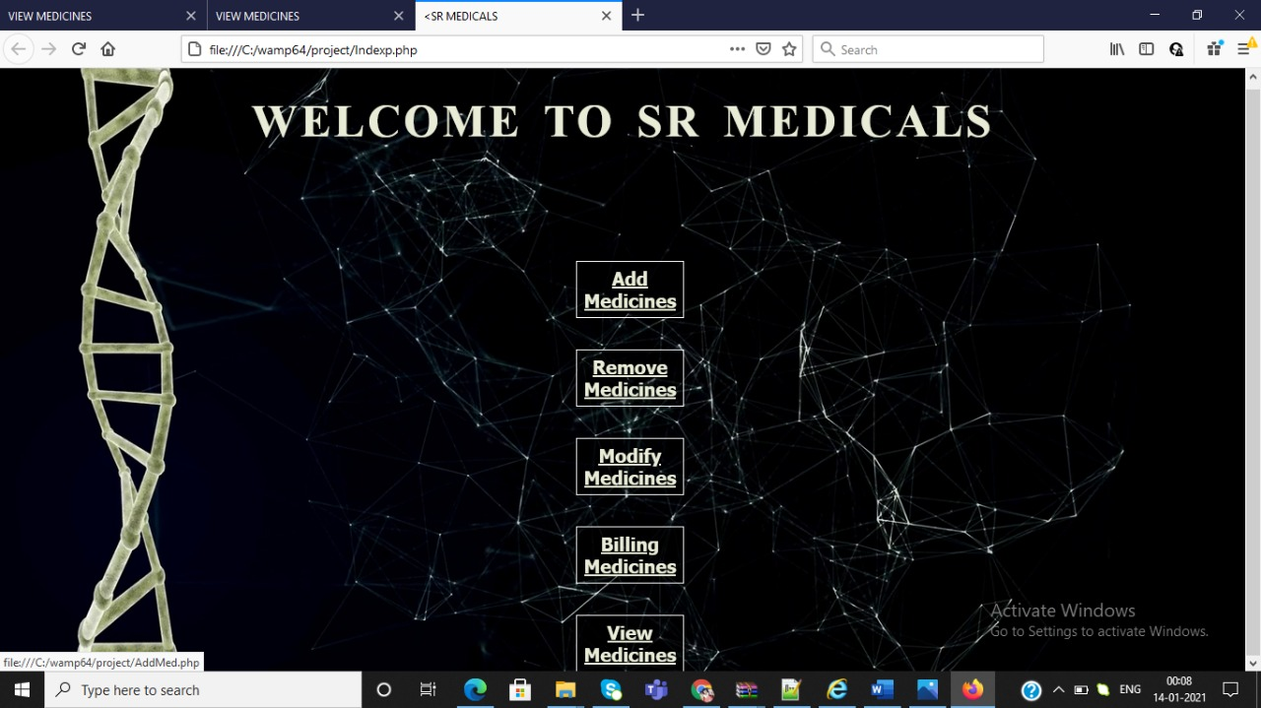
SCREENSHOTS
Fig 1:Login page

Slide 8
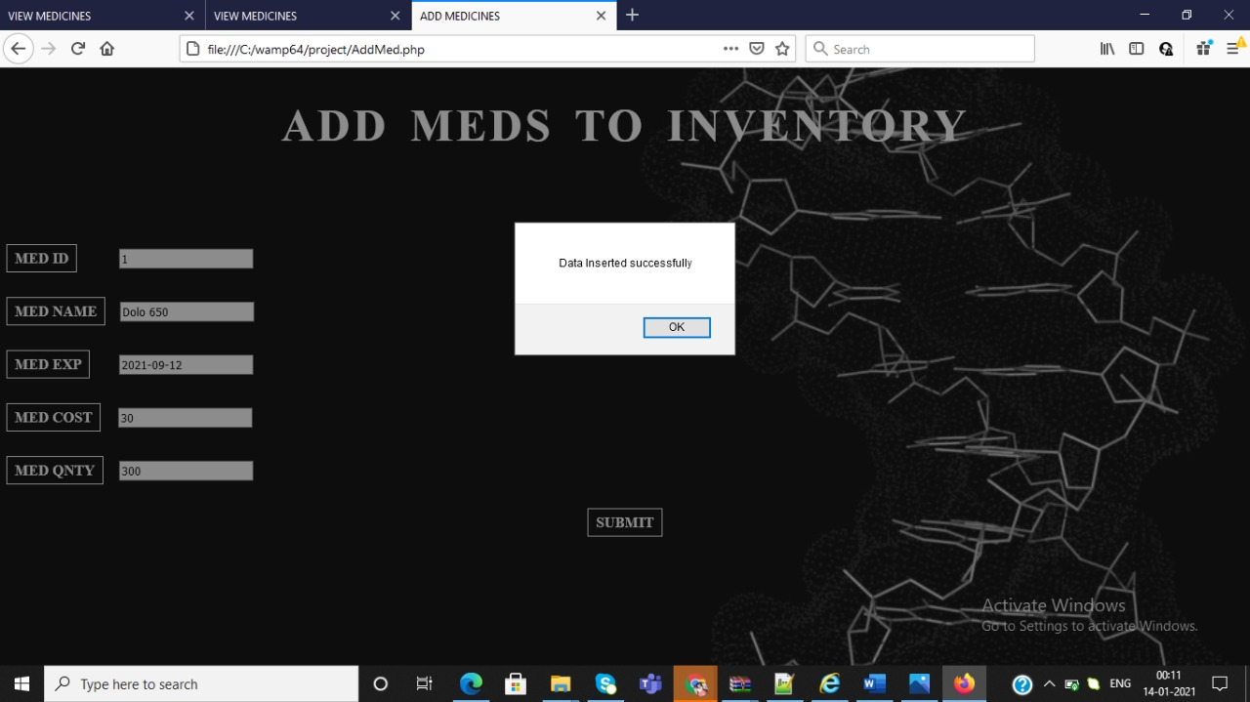
Fig 2:Add Medicine

Slide 9
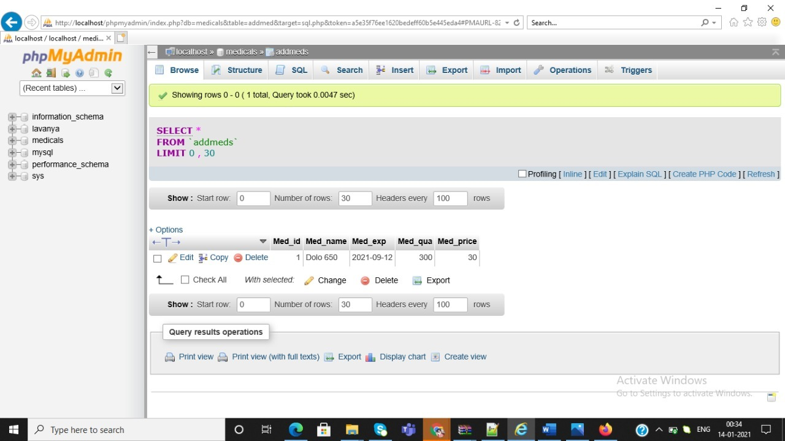
Fig 3:Add Medicine database

Slide 10
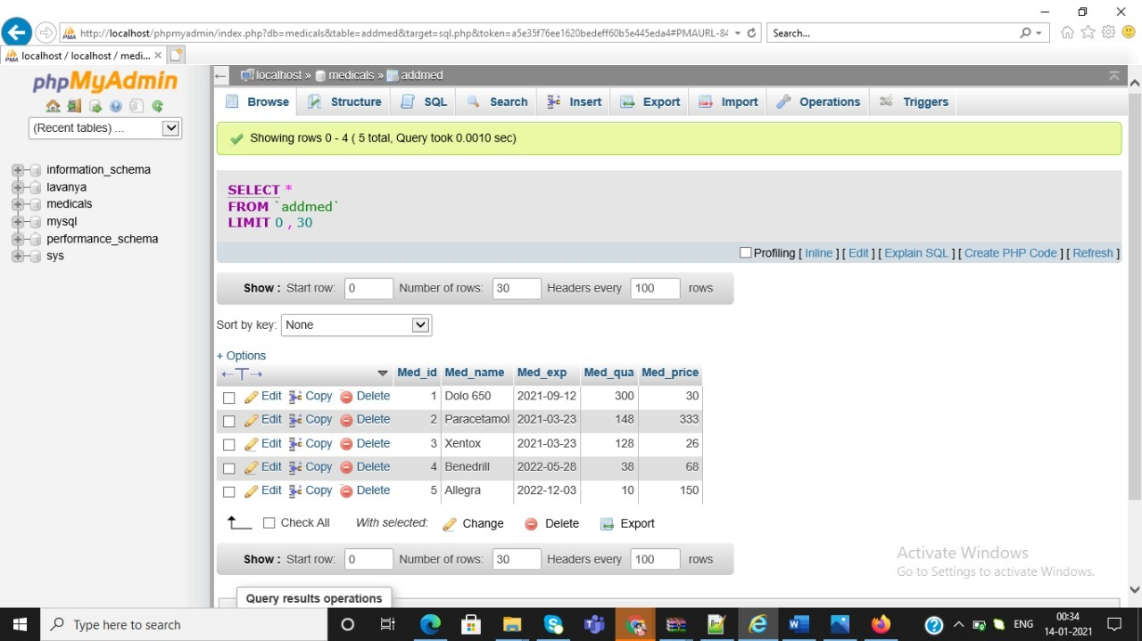
Fig 4:Add Medicine database

Slide 11
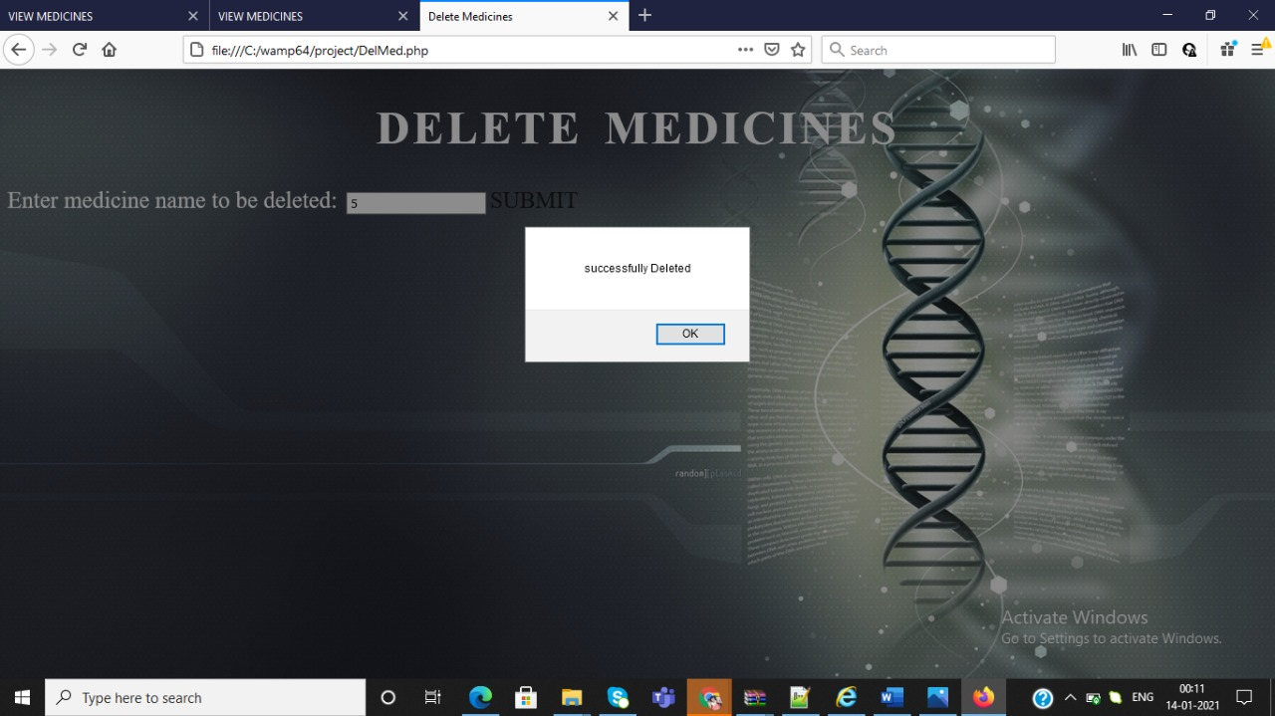
Fig 5:Delete Medicine

Slide 12
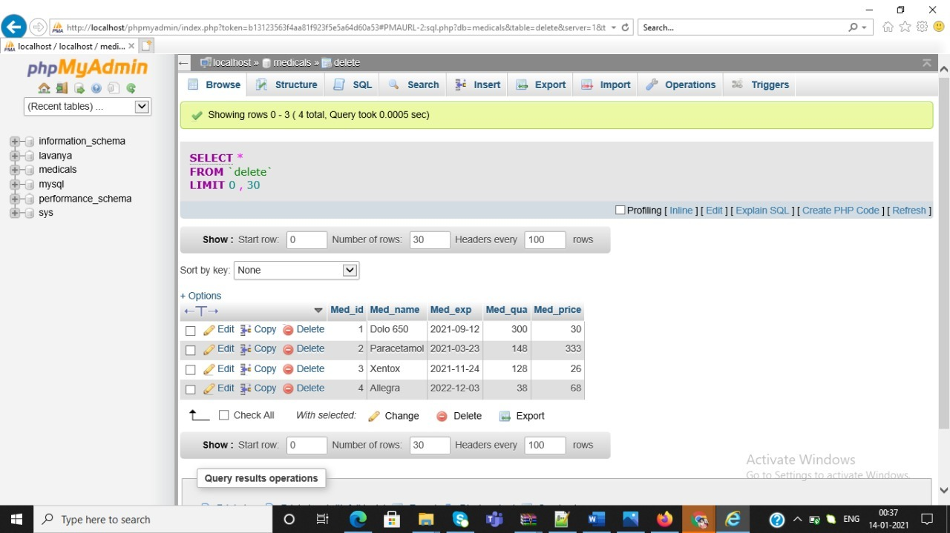
Fig 6:Delete Medicine database

Slide 13
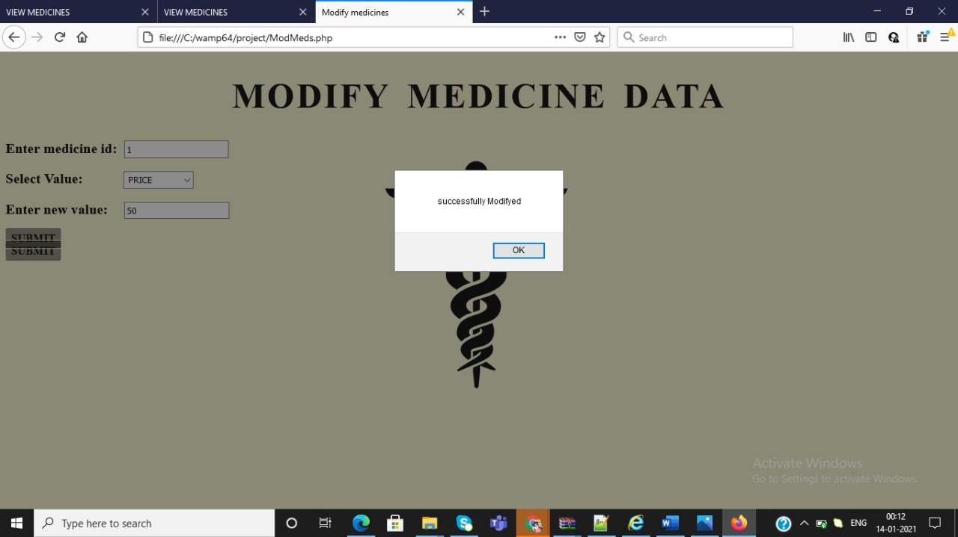
Fig 7:Modify Medicine

Slide 14
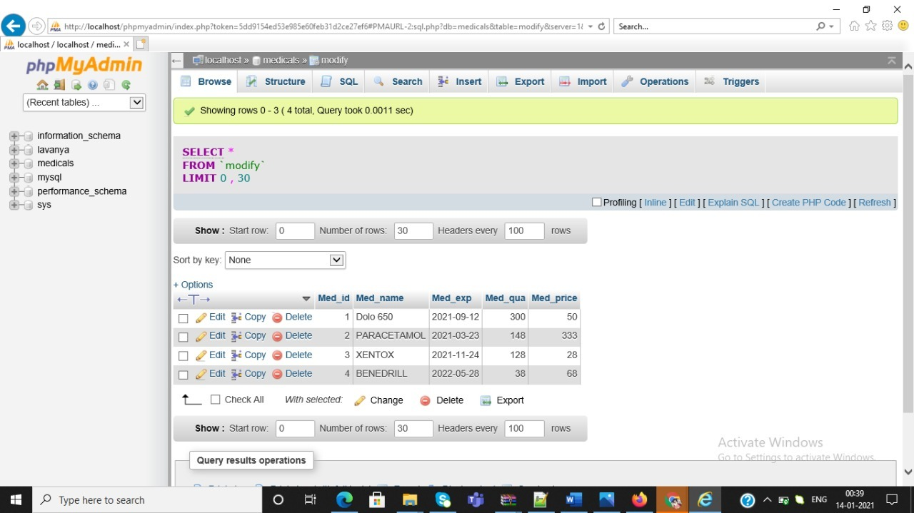
Fig 8:Modify Medicine

Slide 15
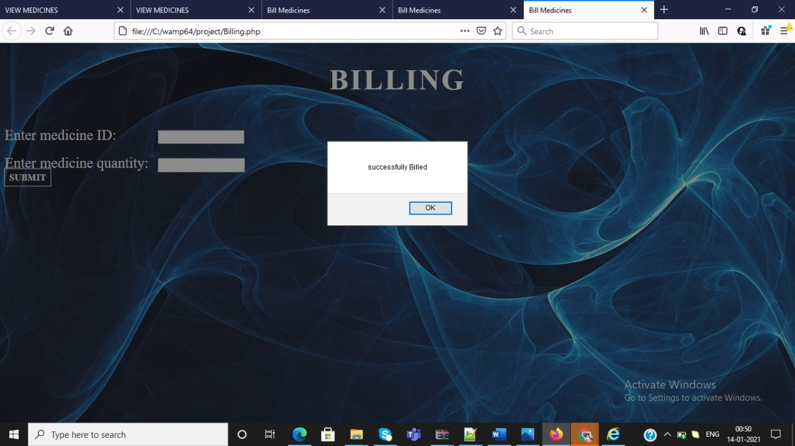
Fig 9:Billing

Slide 16
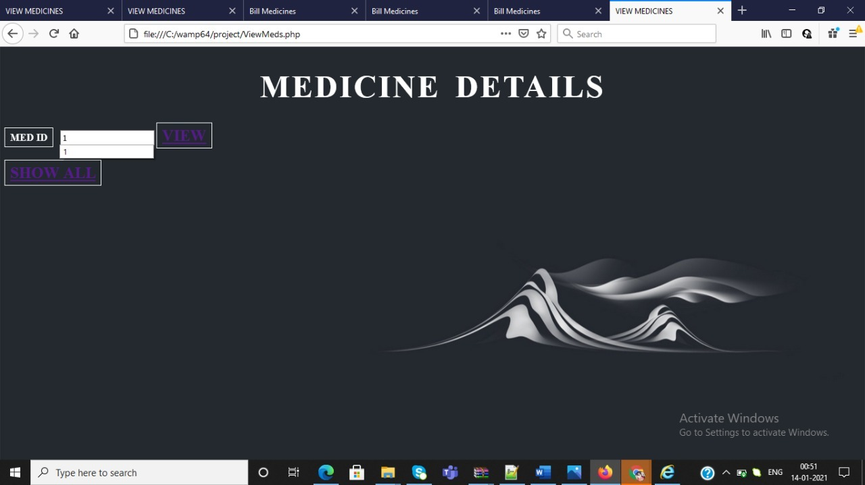
Fig 10:Medicine Details

Slide 17
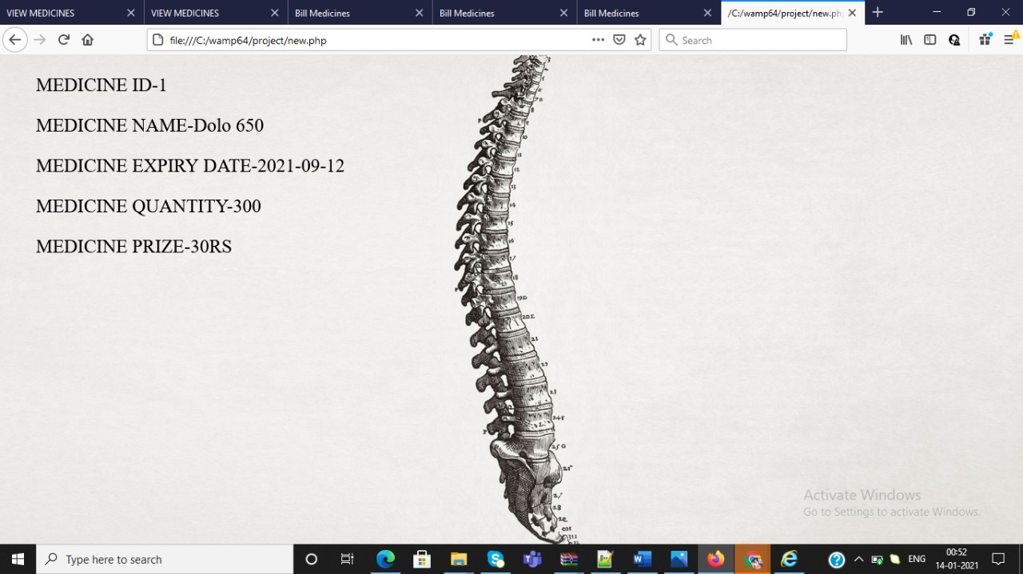
Fig 11:View Page

Slide 18
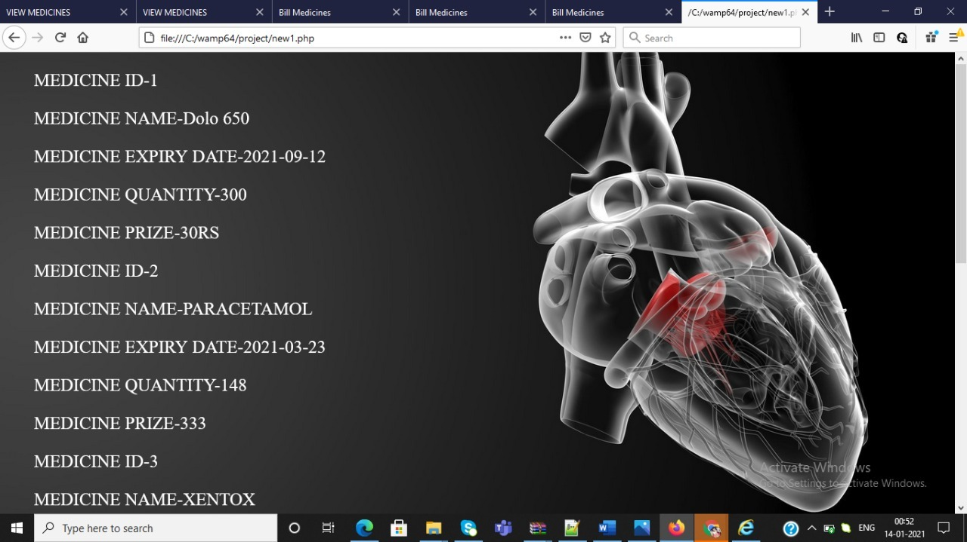
Fig 12:View Show All

Slide 19
THANK YOU

